Slide 1
Spring Update 5
Dev Bhatia
Boston University College of Engineering
Ultrafast Optics Laboratory

Slide 2
Points of Note
Modified size of box
Found a way to have a single medium
Created larger array of temperature sensors
Altered fiber tilt
Better understanding of “z-focus”

Slide 3
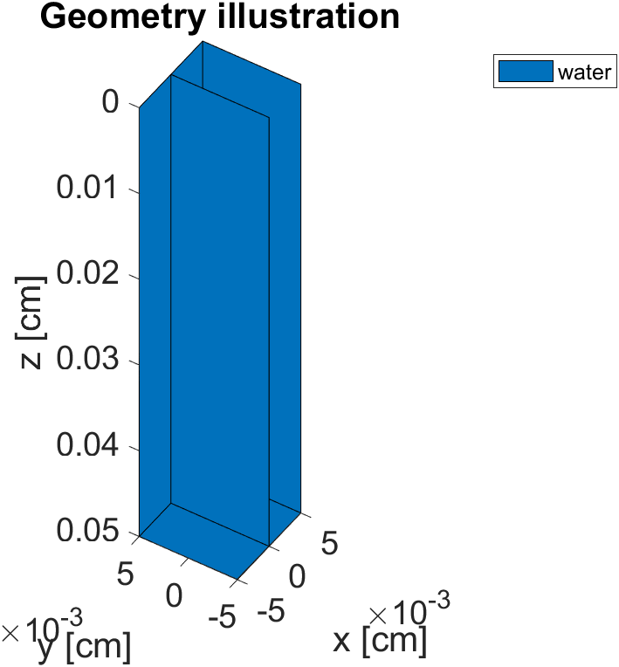
Box Size Modifications
The scale of many of the examples lead to inaccurate results when modifying parameters on the micro scale
The model size has been reduced to better fit the scale of the project
This, however, increases the overall computation time
Granularity of the program (number of voxels) decreased as a result
Fig 1 – Geometric Illustration

Slide 4
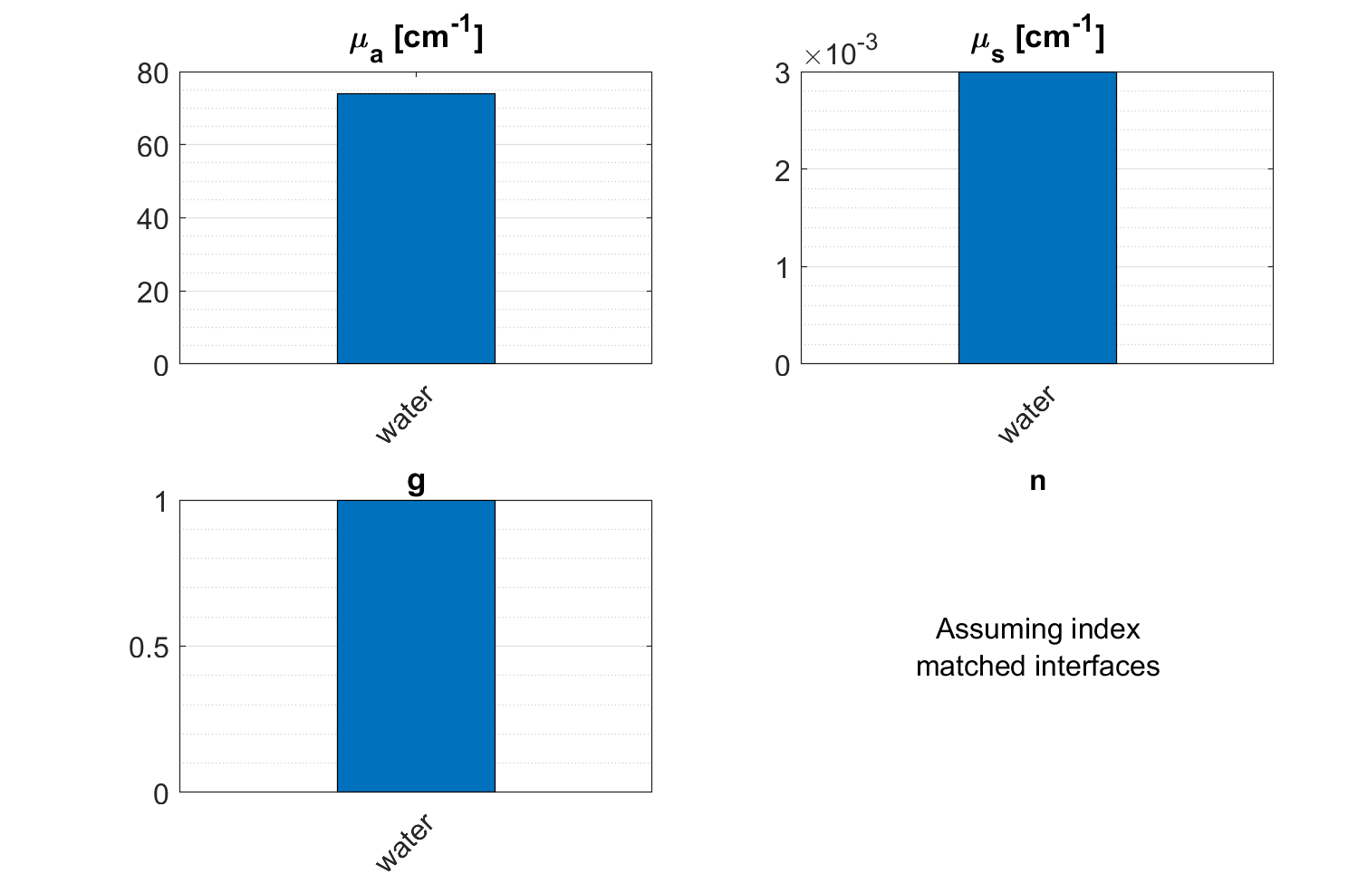
Single Media
We were hampered before by the “simple tissue” from many of the examples provided
We can subvert this by introducing the tissue below the bounds of the simulation cuboid
Changed the scattering coefficient to μs = .003 cm ^ -1
Fig 2 – Media Properties of Water

Slide 5
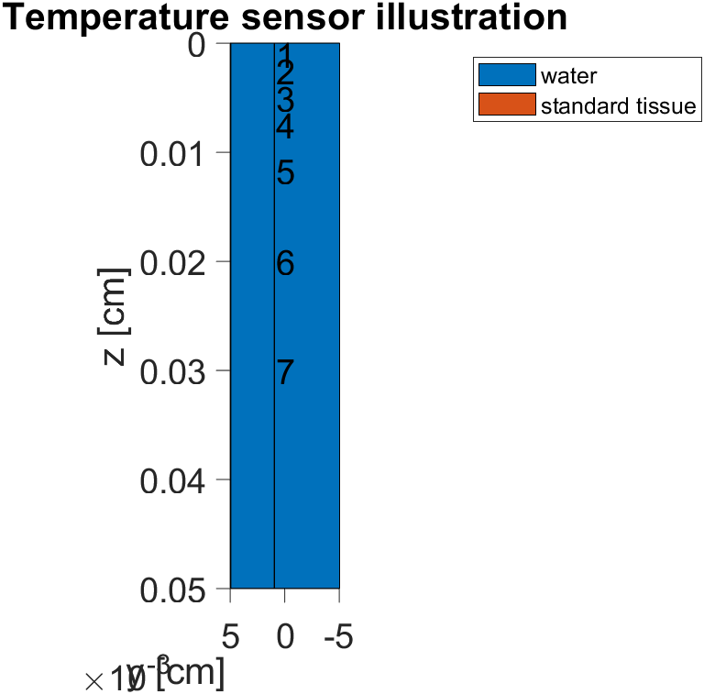
Larger Number of Temperature Sensors
After every simulation, the program outputs the “highest temperature observed”
To find where that is, many temperature sensors were placed around the highest temperature zone
Fig 3 – Temperature Sensors

Slide 6
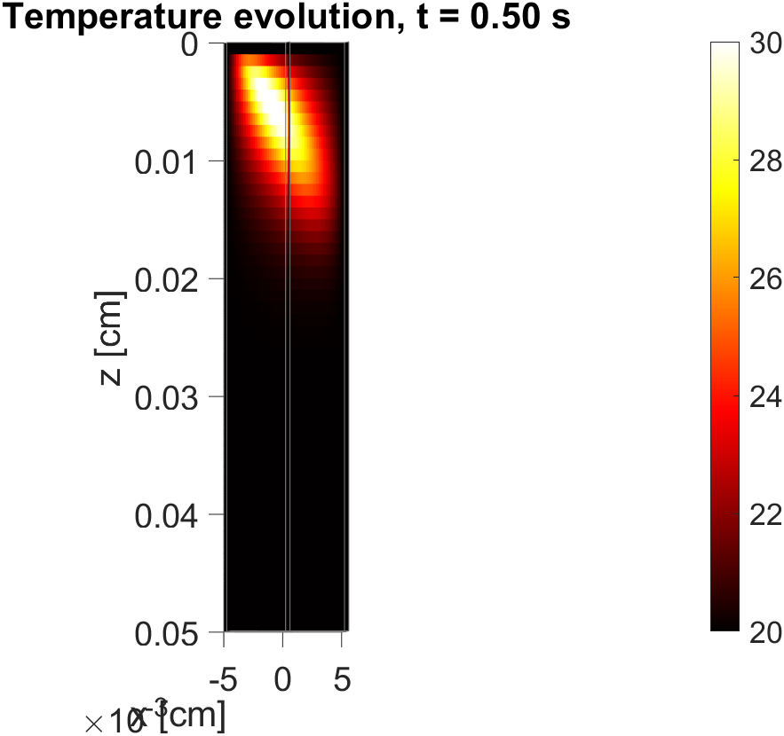
Altered Fiber Tilt
In order to better match the experimental design, the fiber was tilted
Used a polar angle of 1.0821 radians (62 degrees)
Important note – perpendicular = 0 degrees
Fig 4 – Temperature Evolution (X-Z plane)

Slide 7
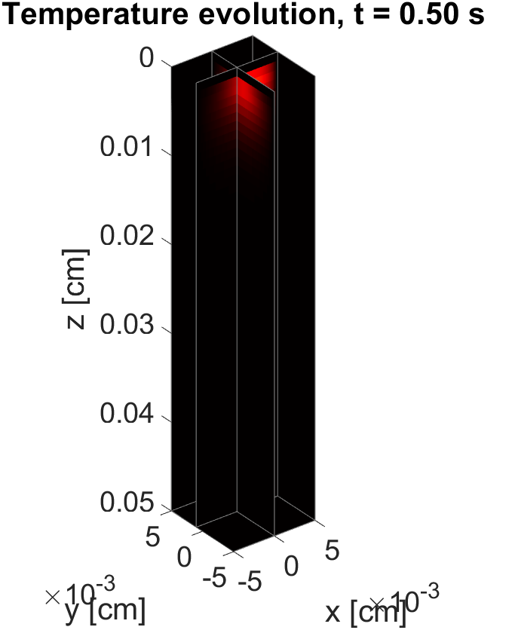
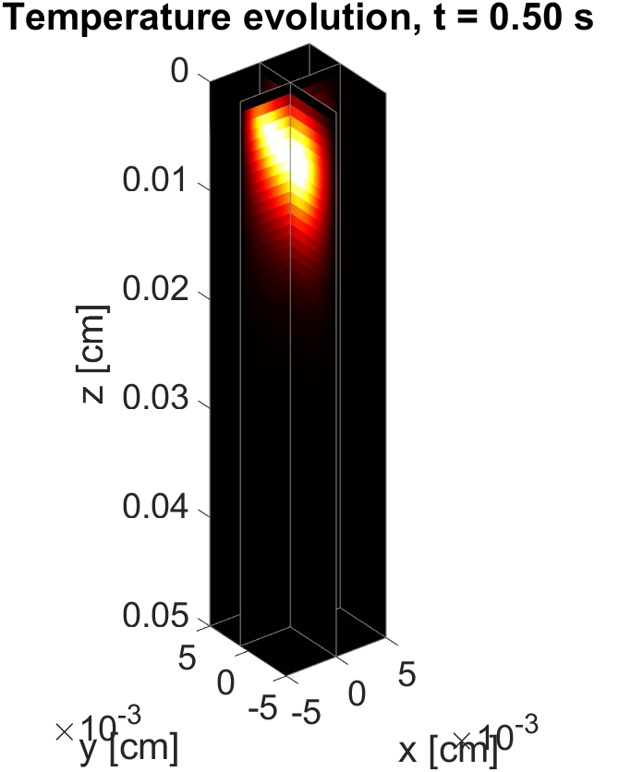
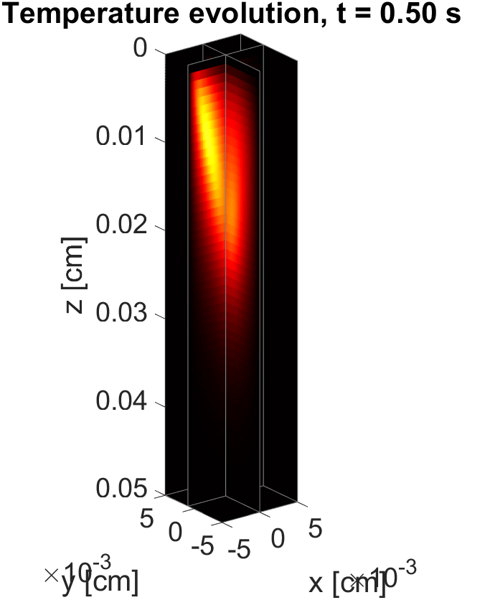
Z-Focus
The Z-Focus does not relate to the fiber’s absolute position
Increasing the z-focus elongates the beam
Fig 5 – Temperature Evolution; z focus = 0.0 cm
Fig 6 – Temperature Evolution; z focus = 0.01 cm
Fig 7 – Temperature Evolution; z focus = 0.025 cm

Slide 8
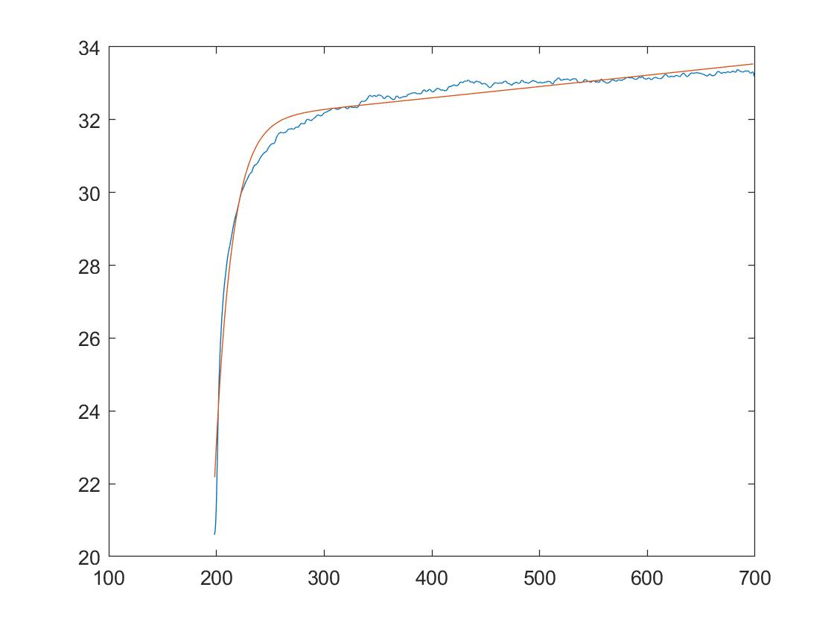
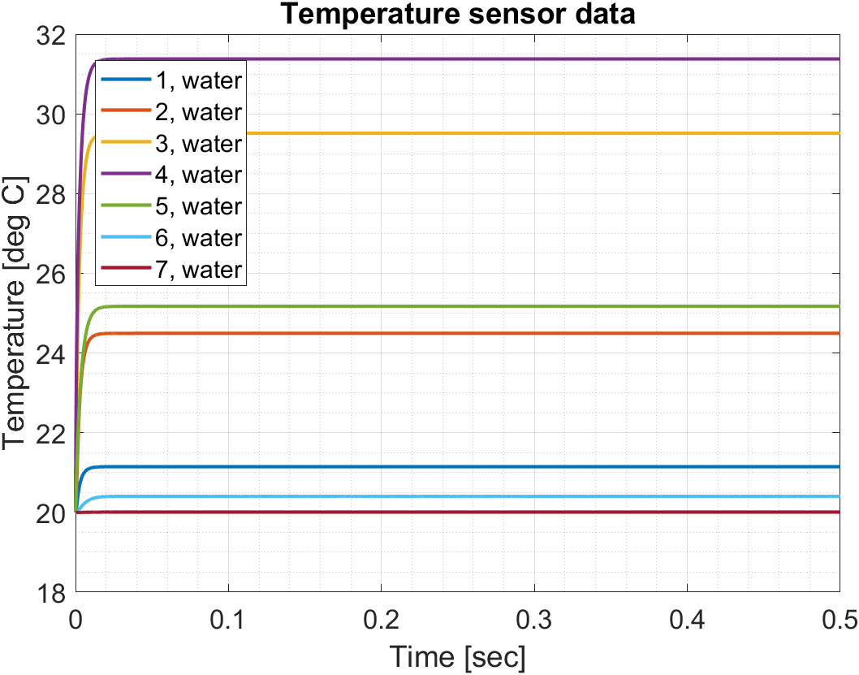
Temperature Transients
Experimental Data
Temperature (deg C)
Time (ms)
Fig. 8 – Experimental Data, plotted using Matlab
Fig. 9 – Temparature Sensor data – MCMatlab; z focus = 0.01 cm

Slide 9
Notes
The highest temperature in the final simulation was said to be 32.43˚C
Likely located off the z-axis
Very harsh plateau in simulation results
Investigating more about the simulation parameters (particularly those involved with the fiber) could prove fruitful
Fiber is still at the water surface

